Slide 1
WGO Member Societies
Online Member Society Information and Update Form
MAY 2022

Slide 2
Member Society Dues and Information Update Form
There are three ways to access the form. Please use whichever you prefer:
Use this direct link (click or copy/paste): https://wgo.execinc.com/edibo/Dues
From the WGO homepage (illustrated on the next slide)
In the membership section of the WGO website (illustrated on the next slide)

Slide 3
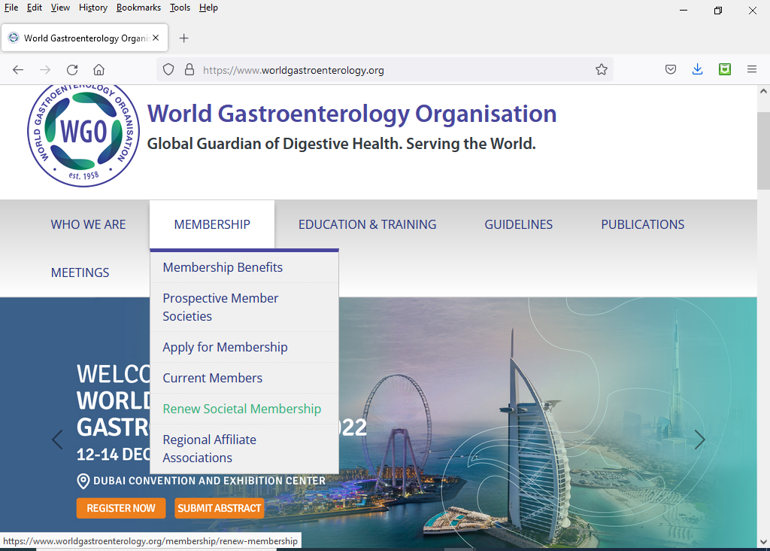
WGO website: www.worldgastroenterology.org
Online Login Link

Slide 4
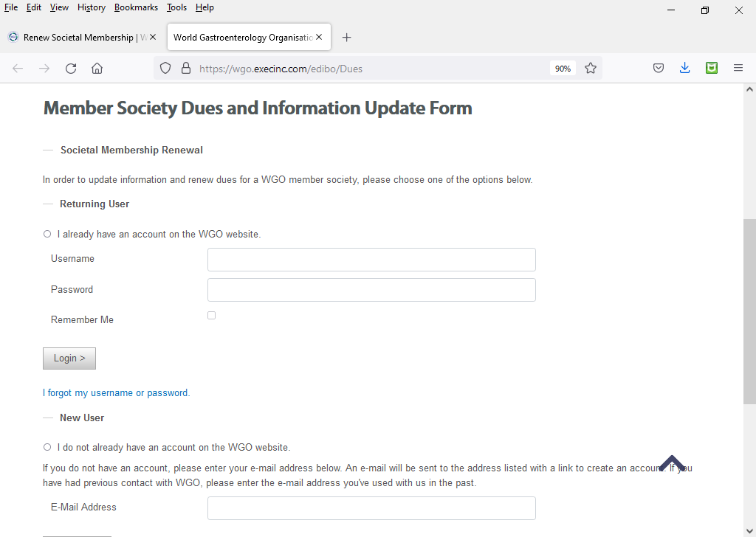
Logging In
Online Login Link #1: https://wgo.execinc.com/edibo/Dues
For Societies that have already set up a username and password, either for Membership or the Training Centers Online System
For first time users

Slide 5
If your Society already has a username and password for the WGO website, then you are a “Returning User”
If you remember your Society’s username and password, enter them to login
If you would like to reset your Society’s username and password, then please select “I forgot my username or password” and enter your respective e-mail address. You will then be sent an e-mail with a link to set your account password.
If you are new to the WGO website and do not have a username and password, then you are a New User.
Select “I do not already have an account on the WGO website.”
Please enter the e-mail address that received the e-mail from WGO and follow instructions to create your account.
You only need to create an account one time. For future returns to the Member Society Dues and Information Update Form after your username and password are set, please return to https://wgo.execinc.com/edibo/Dues and follow the Returning User instructions.

Slide 6
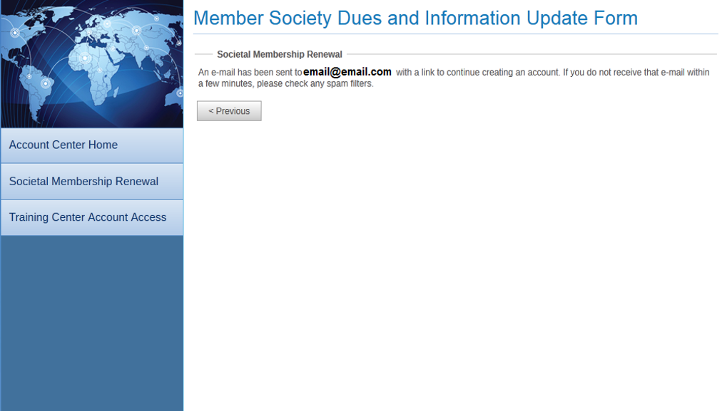
Creating a New Account

Slide 7
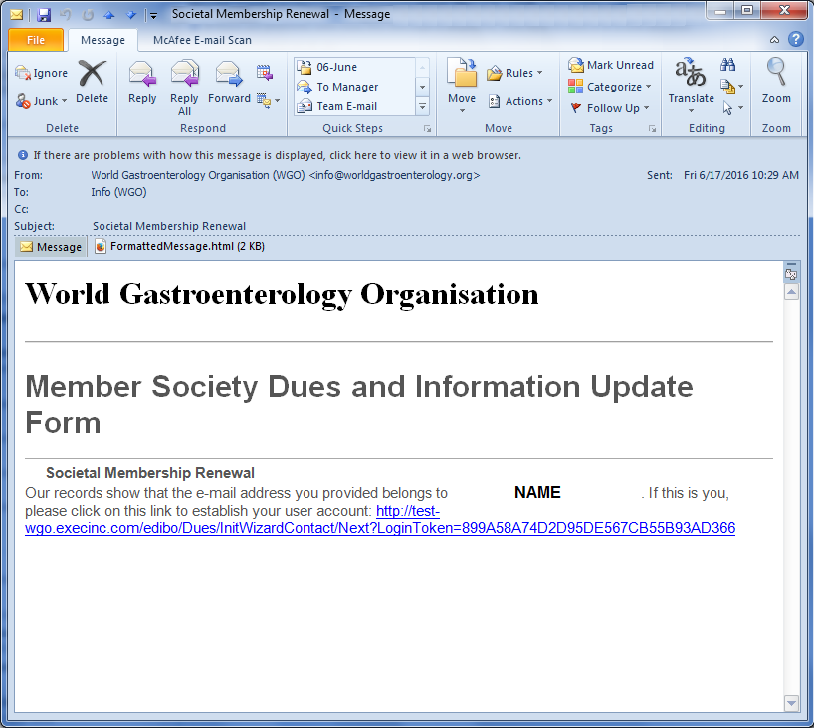
You will receive an e-mail similar to the one below which will direct you back to the WGO website to create your username/password.

Slide 8
Choose your own username
Choose your own password

Slide 9
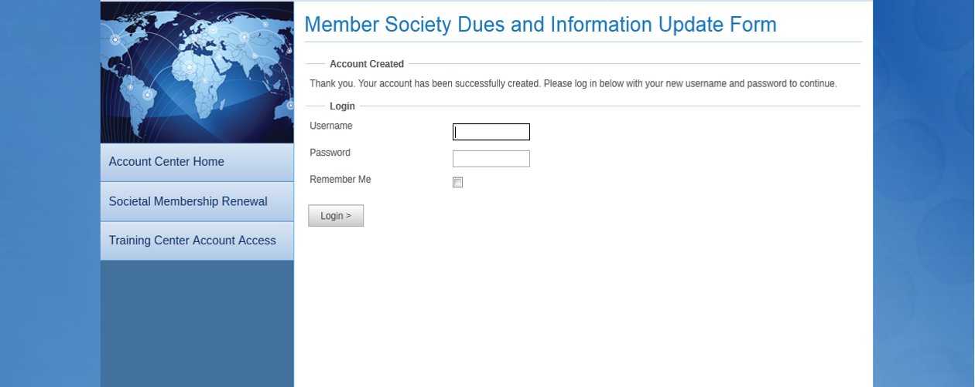
Enter the username and password you just created

Slide 10
Some individuals are contacts for multiple societies (for example a regional affiliate and a Member Society). Once logged in, they will have to choose which society they wish to update.
Returning to https://wgo.execinc.com/edibo/Dues will allow them to choose to edit a different society.

Slide 11
Completing the Form
Once logged in, you will see the menu for Member Society Dues and Information Update Form. Click any underlined title to view and edit that section.
A check indicates this section is complete

Slide 12
Completing the Form
Fields marked with an asterisk (*) are required
Some fields may pre-populate, please review and confirm/correct all information
Current Number of Society Members is required to calculate dues amount
Use buttons to move between sections or to return to the menu

Slide 13
Complete all sections:
Society Details
Upcoming Annual Organizational Meetings
Upcoming Organizational Anniversaries/Milestones
Officer Information
Society Information
Permanent Secretariat
President
Secretary

Slide 14
Review and submit your form
You will see a review of all information submitted. If edits are needed, follow the link to go back to the menu. If all of the information is correct, click Continue at the bottom of the page to go to your billing summary.

Slide 15
Billing Summary
Total due based on number of Society members
Last chance to go back to previous pages
Click to finalize your update form and receive your Membership Dues Invoice

Slide 16
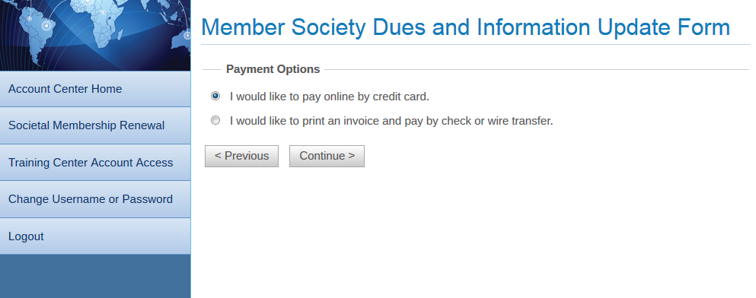
Payment Options
In addition to wire transfers and checks, WGO accepts credit card payments. Choose your payment method on this page:

Slide 17
Completing Your Renewal
If you paid using a credit card, you will be sent an email verifying the transaction.
If you chose to pay via wire transfer or check, an invoice will be generated.
A copy of your invoice will also be sent to your e-mail address
All amounts due are in US Dollars (USD)
Please ensure that your society number is included on the bank transfer

Slide 18
If you paid by credit card you will receive an e-mail similar to the one below

Slide 19
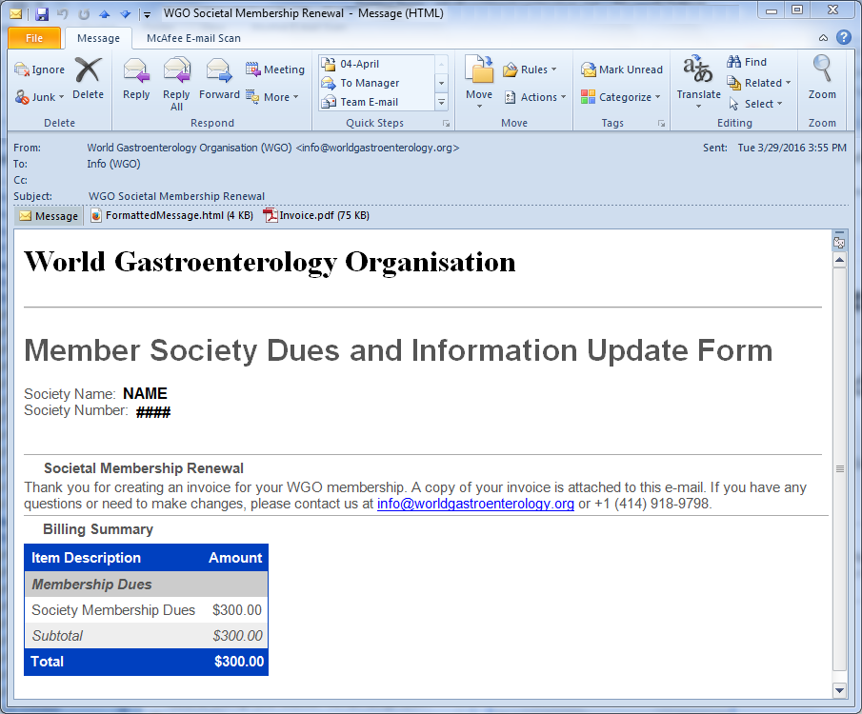
If you chose wire transfer or check you will receive an e-mail similar to the one below with a copy of your invoice

Slide 20
Member Society Number
Total Amount due in US Dollars
Invoice due date

Slide 21
Questions?
Please contact the WGO Executive Secretariat:
E-mail: membership@worldgastroenterology.org
Phone: +1 (414) 918-9798

